Slide 1
Transfopower Limited
Transfopower Din Rail Meter Collector System
Muhammad Faique
Contact:faique@transfopower.net

Slide 2
Introduction
Transfopower as a leading provider of innovative solutions for the power industry. Managing the large volumes of data generated by machines can be a major challenge, particularly as data needs to be stored for long periods of time for analysis and regulatory purposes. Power monitoring systems need to integrate in such a way, so user can view a complete picture of the power system.

Slide 3
Problem Statement
The power industry faces significant challenges when it comes to power monitoring. One of the main problems is the difficulty of collecting and managing large amounts of data from a network of meters and machines. This can result in delays in identifying issues or inefficiencies, which can lead to higher costs and lower performance.

Slide 4
Solution
Our solution to this problem is the Transfopower Din Rail Meter Collector System dashboard. The dashboard provides a comprehensive view of the entire network of meters and machines, allowing users to easily monitor voltage, load, and other relevant parameters in real-time. The system also includes an option to automatically add new meters to the network, saving users time and effort.
The dashboard allows users to customize the view of the network, organizing meters into a tree with machines and departments at the top level. This makes it easy to navigate and identify issues or inefficiencies at different levels of the network.

Slide 5
Benefits:
The benefits of our Transfopower Din Rail Meter Collector System dashboard are numerous. Firstly, it provides users with real-time monitoring of key parameters, allowing them to identify issues or inefficiencies quickly and efficiently. This can lead to improved performance and lower costs over time.
Secondly, the dashboard allows users to customize the view of the network, making it easier to navigate and identify issues or inefficiencies at different levels. This can save users time and effort in managing the network.
Finally, our dashboard includes an option to automatically add new meters to the network, saving users time and effort in managing the network. This can lead to improved efficiency and a more streamlined approach to power monitoring.

Slide 6
Features
Meter Management
Add Machines and Meters to Network Tree
View Instant Load and Analysis
View Monthly and Yearly Analysis
User Management
a. Change User Credentials b. Add/Remove Other Users

Slide 7
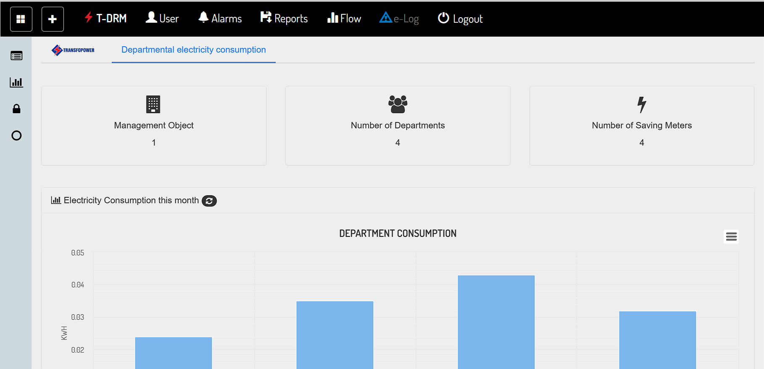
Main Board

Slide 8
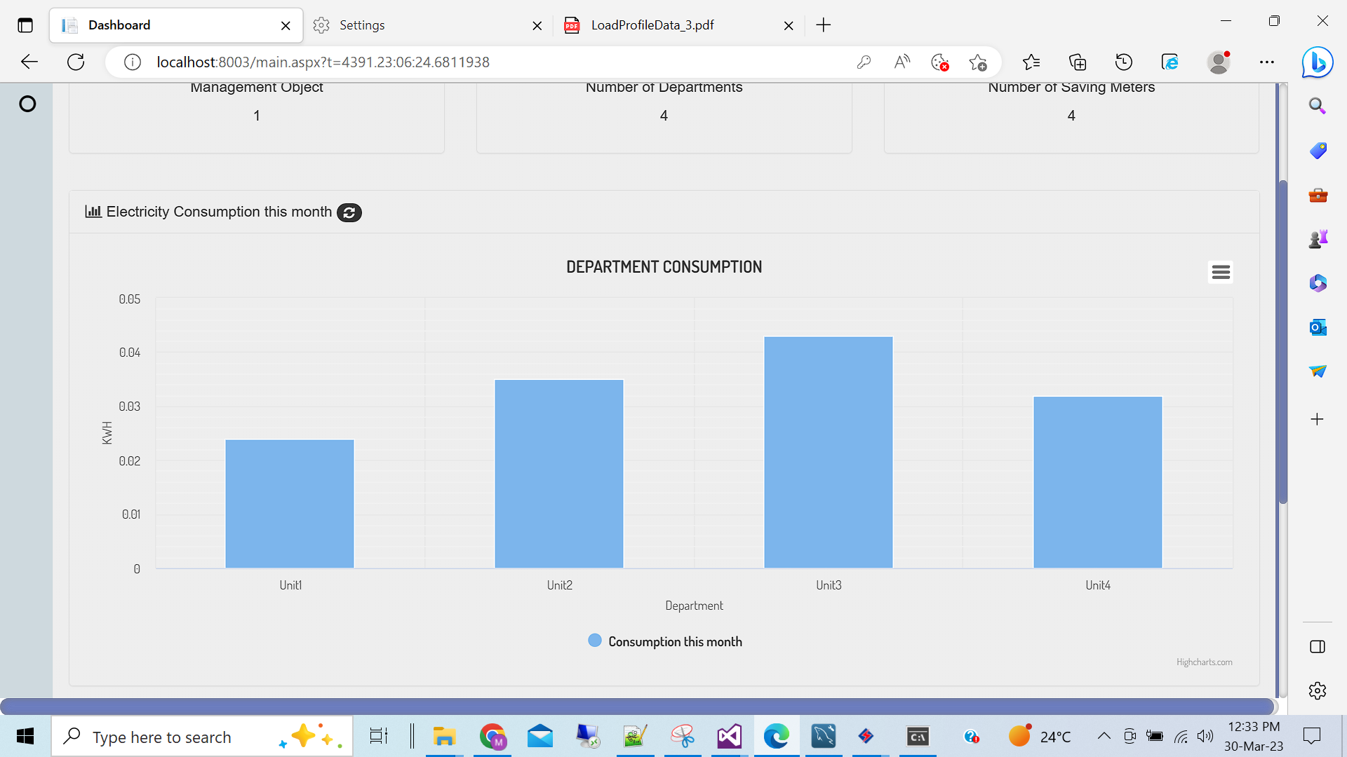
Total Units

Slide 9
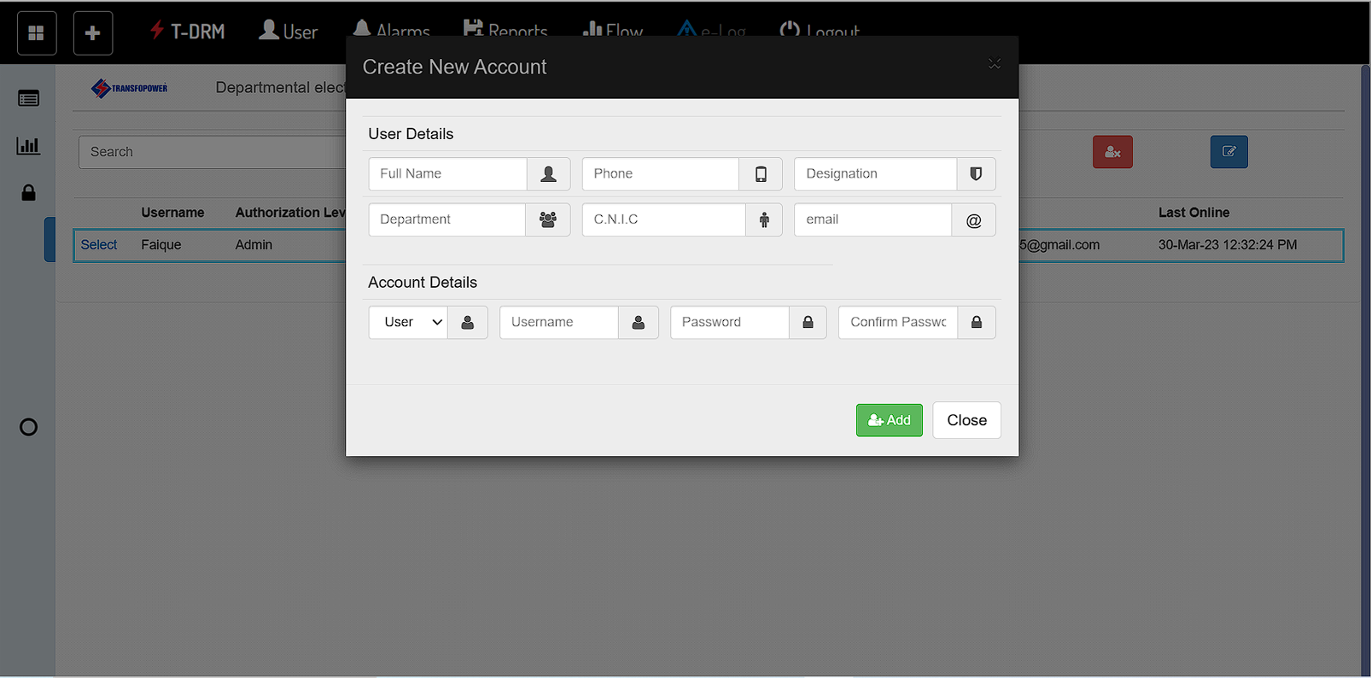
User Management

Slide 10
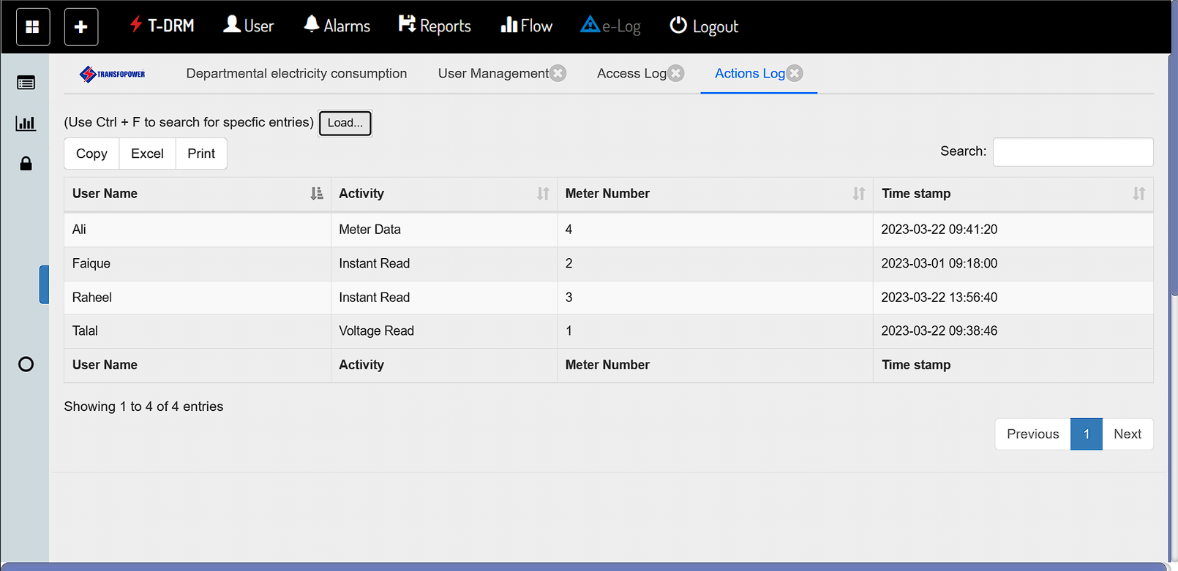
Action Logs
User can see the action logs and operation preformed by other user

Slide 11
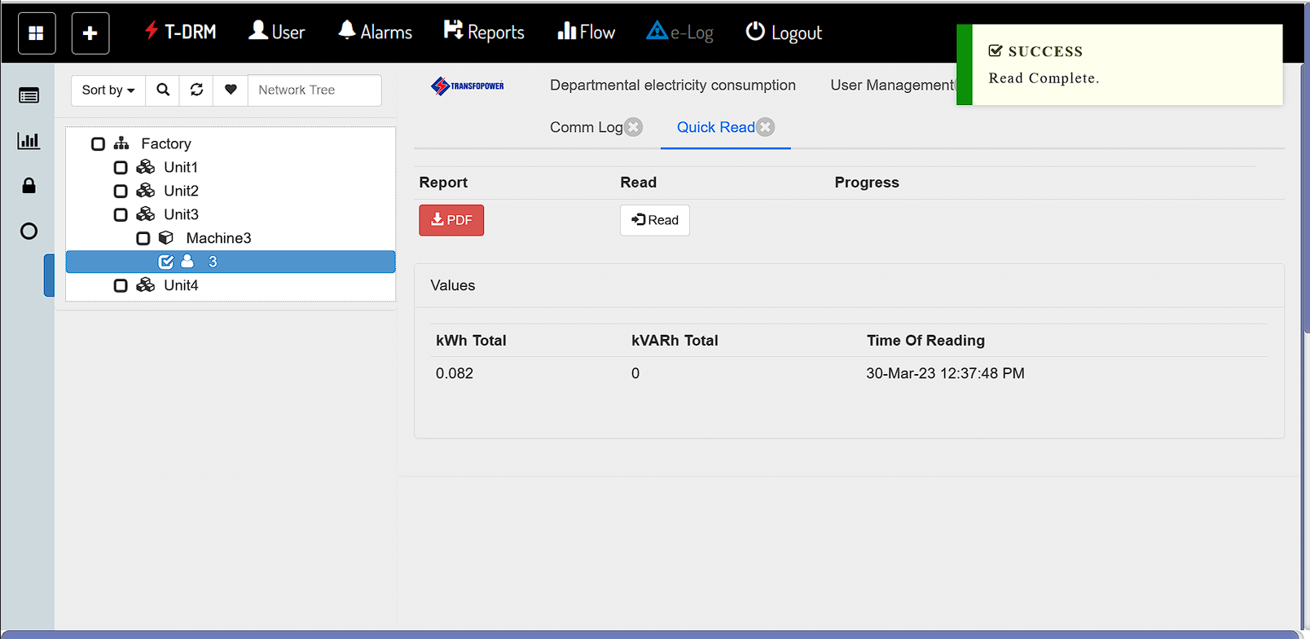
Quick Reading
User Can see live instant Load

Slide 12
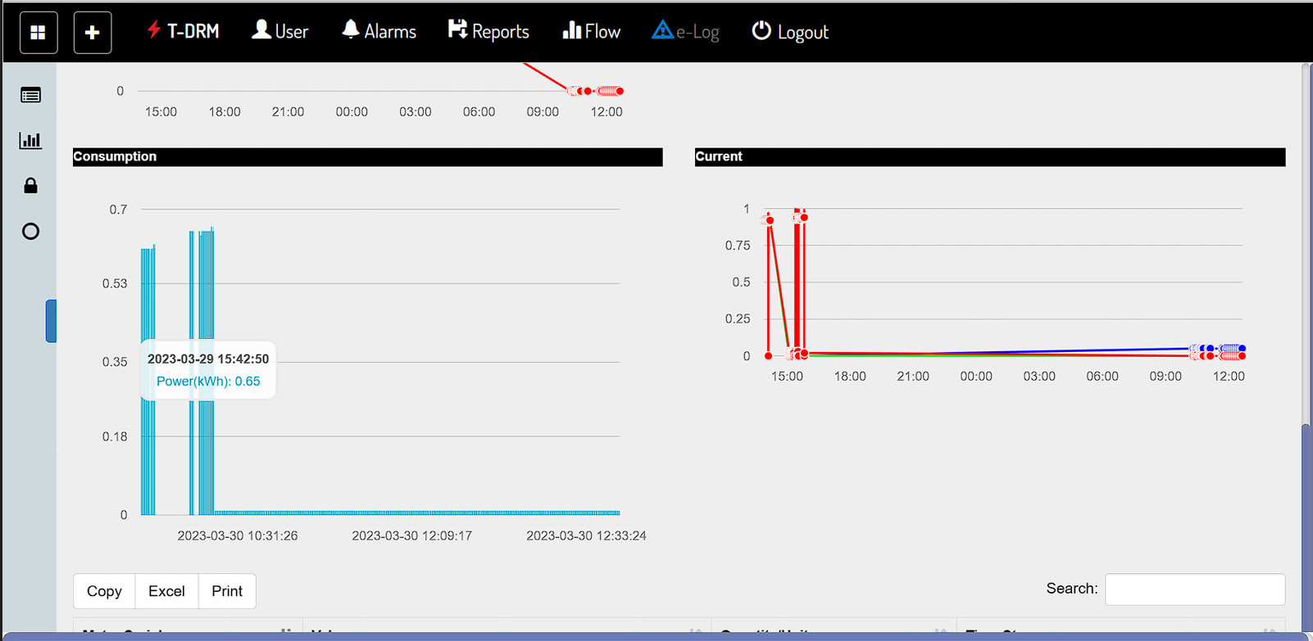
Analysis of Consumption and Current

Slide 13
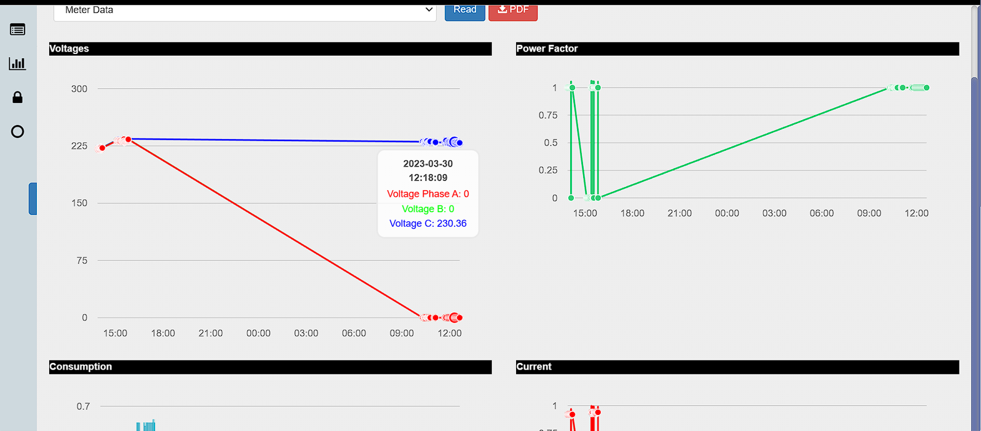
Analysis of Voltage and power Factor

Slide 14
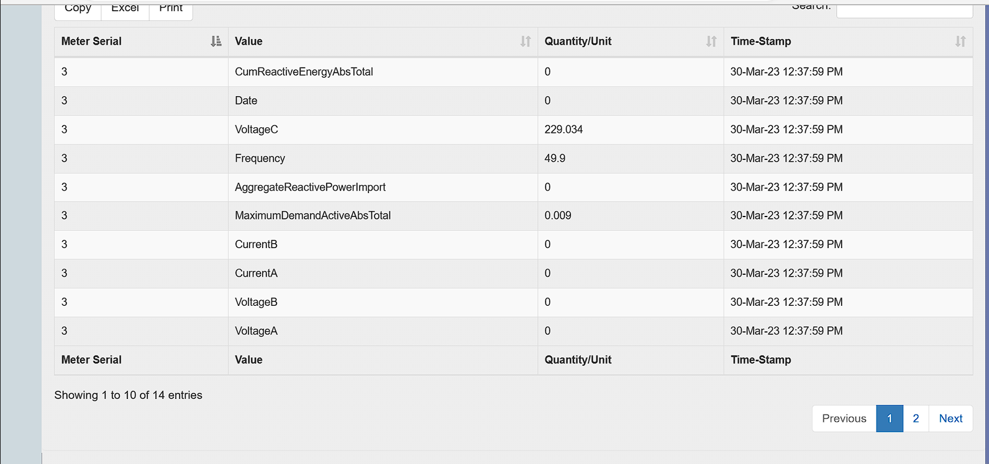
Analysis of Data in Tabular Form

Slide 15
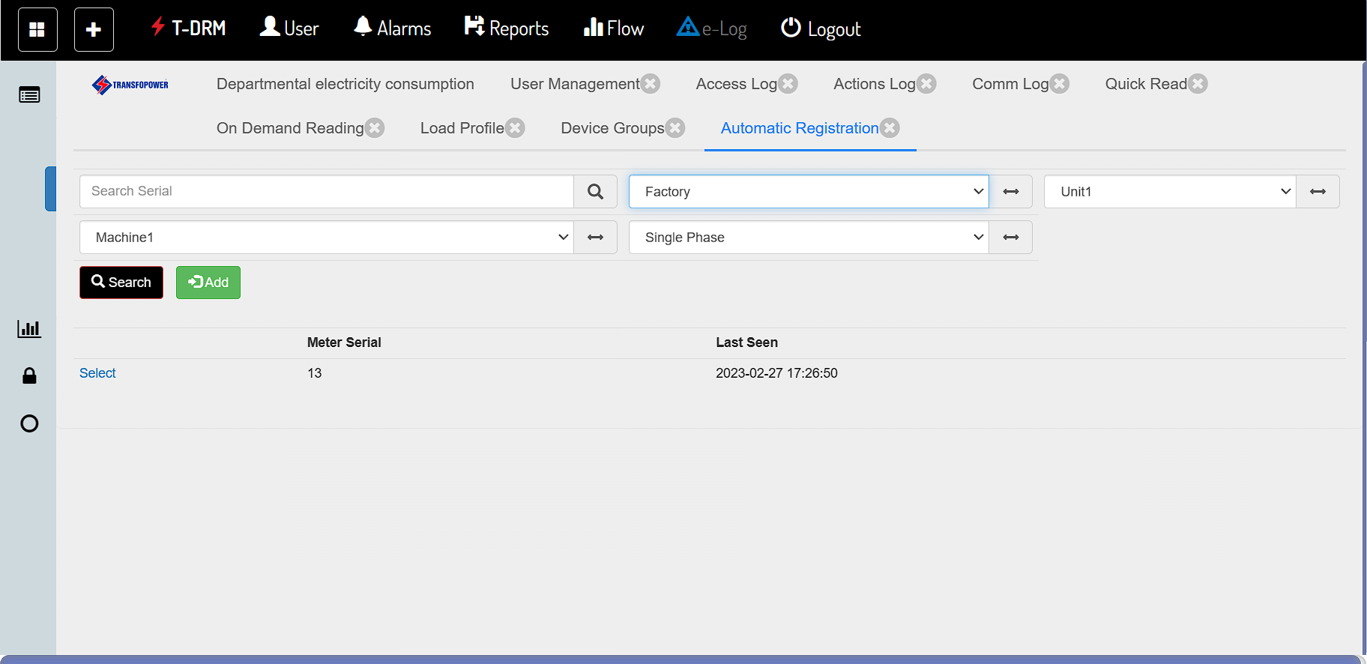
Auto Registration

Slide 16
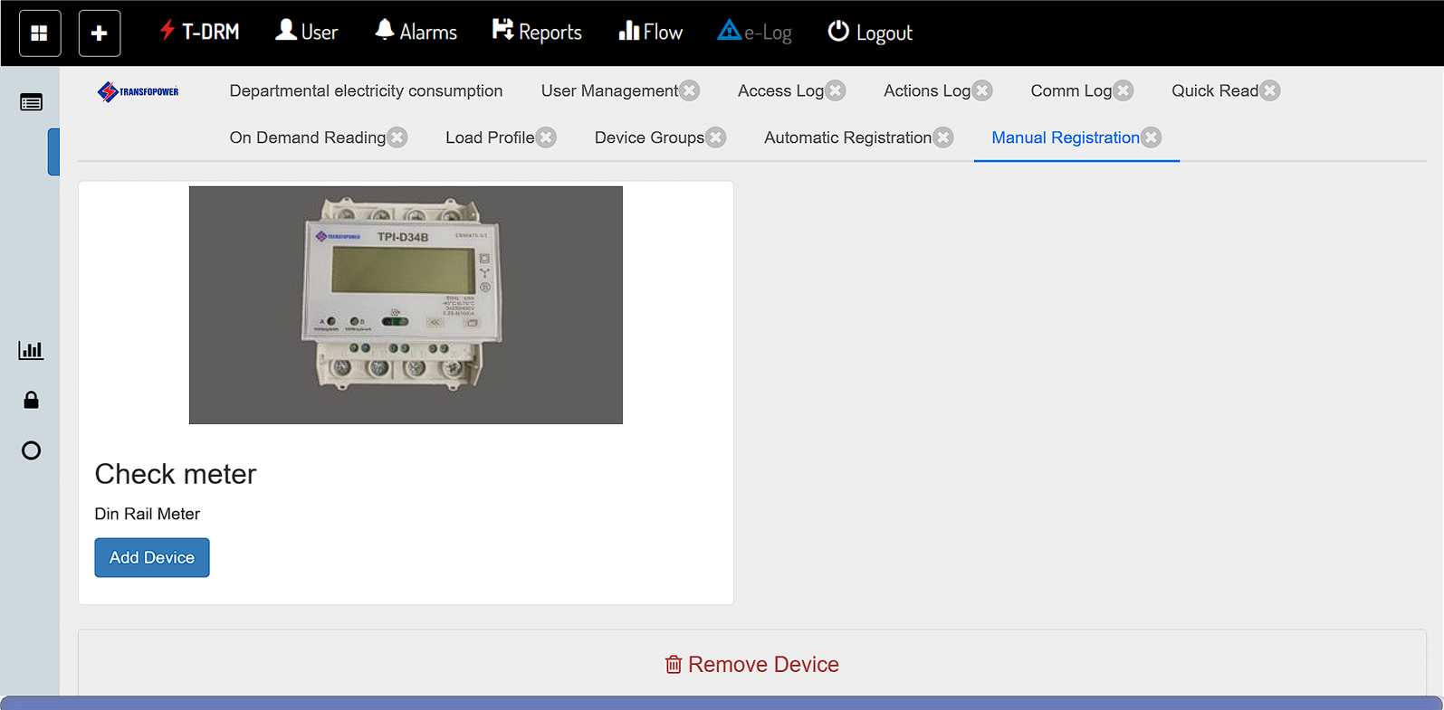
Manual Registration

Slide 17
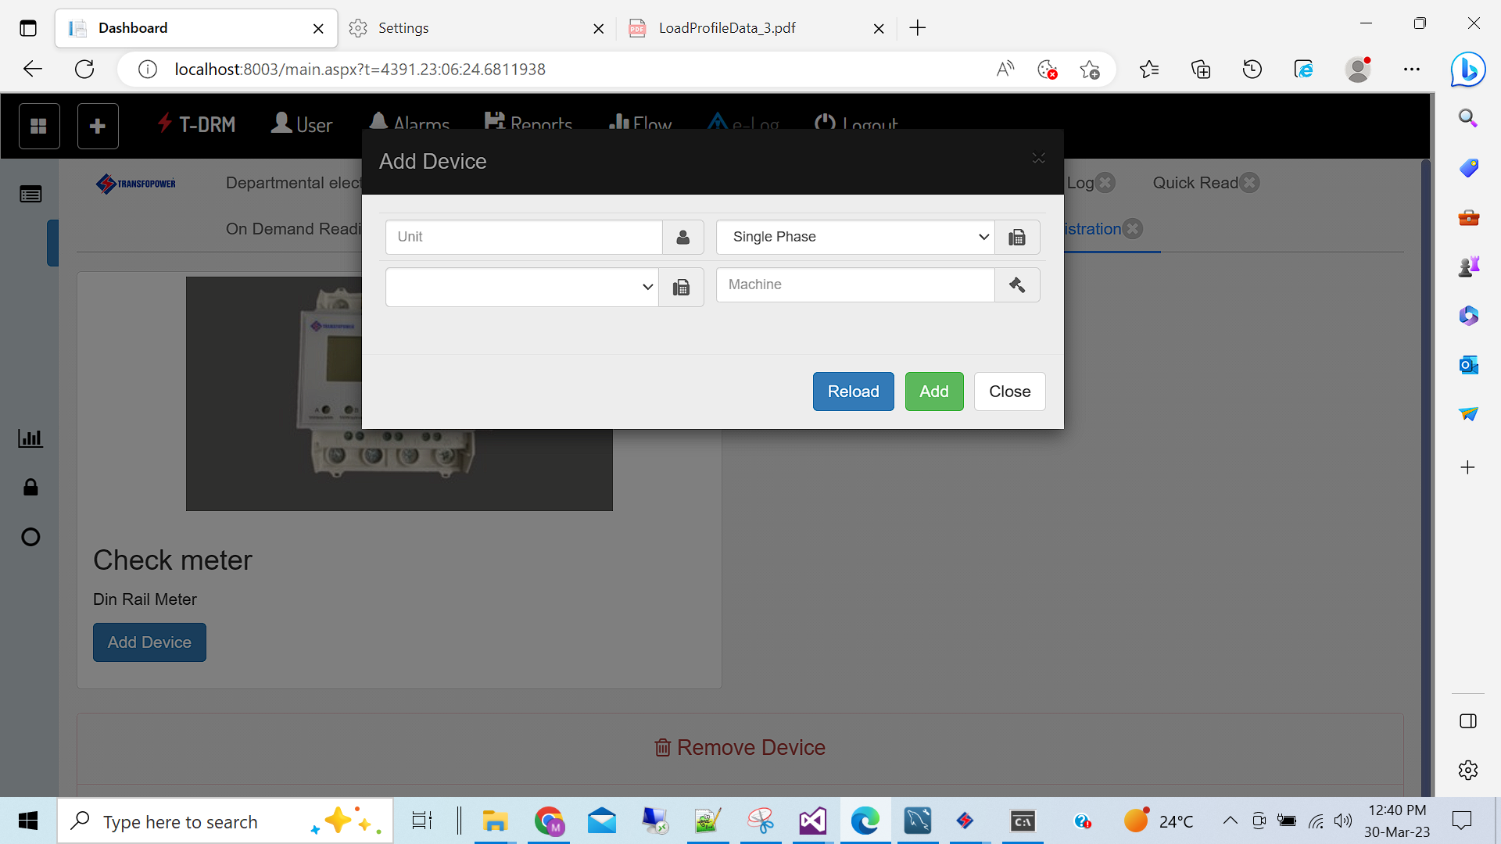

Slide 18
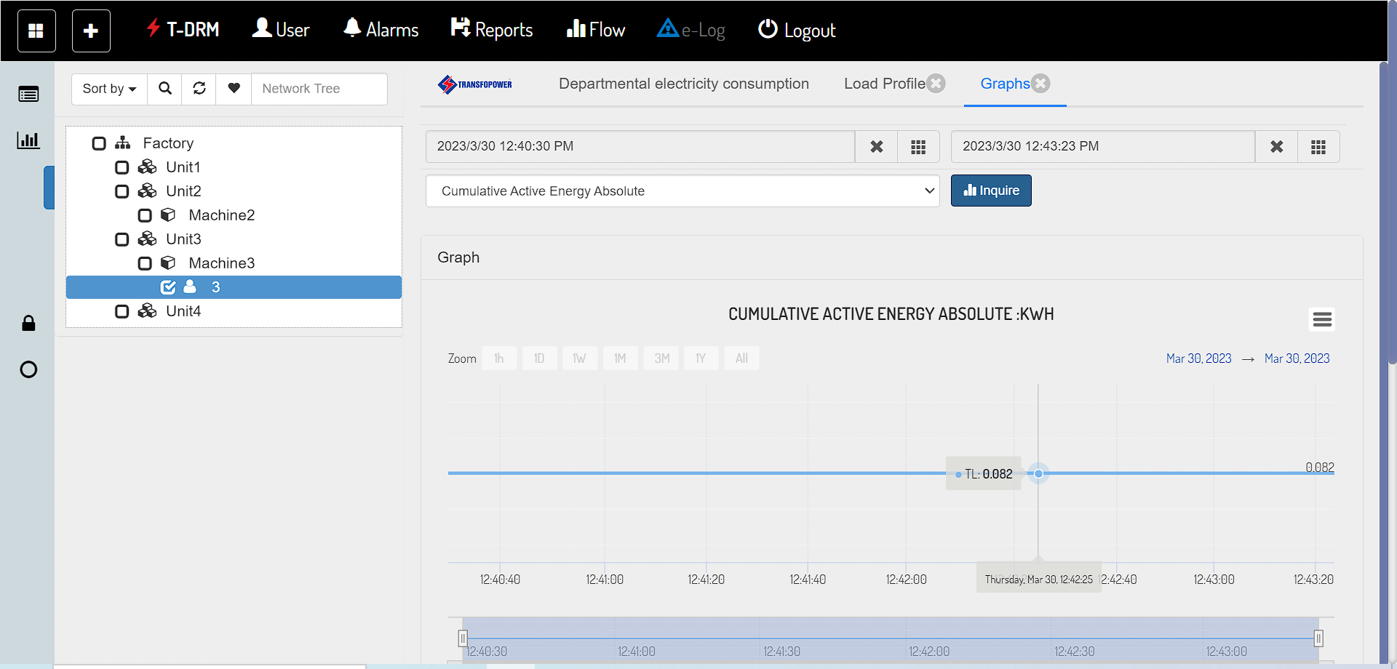
Range Wise Analysis

Slide 19

Reactive Unit

Slide 20
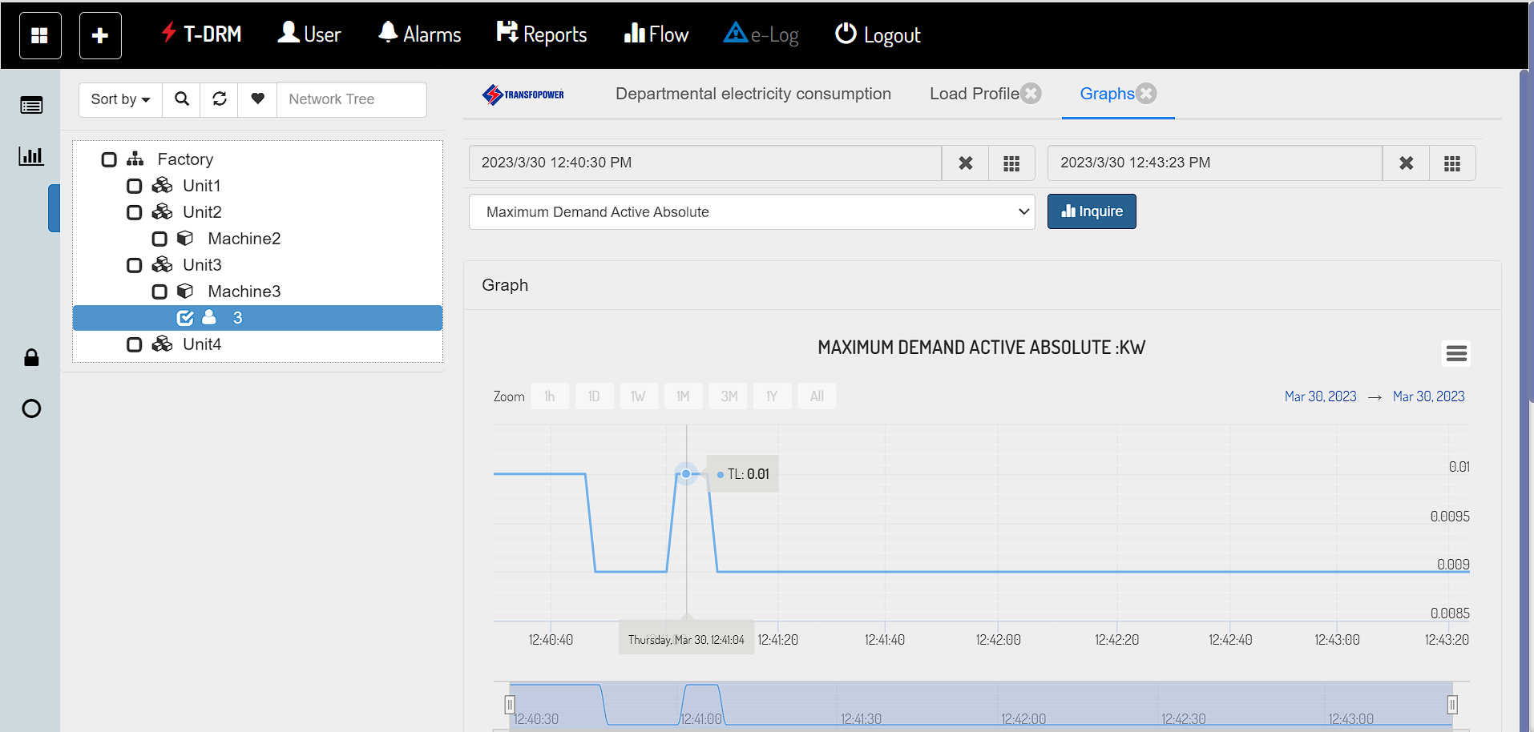
Power Analysis

Slide 21
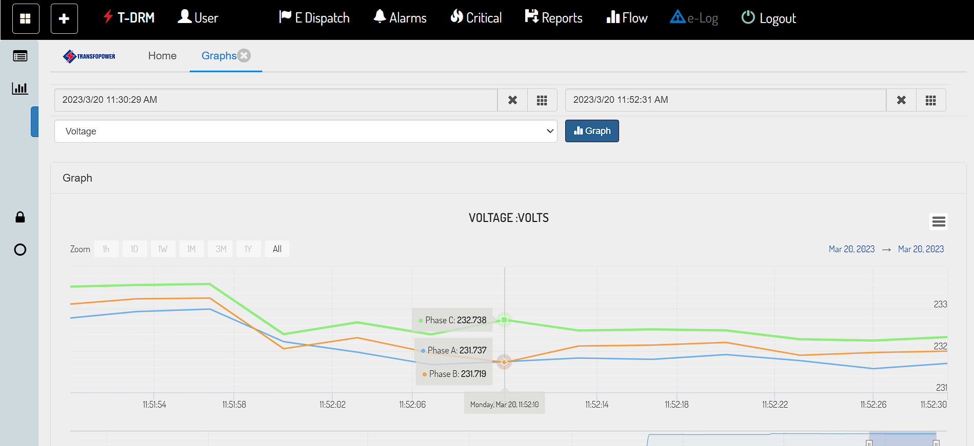
Voltage Analysis

Slide 22
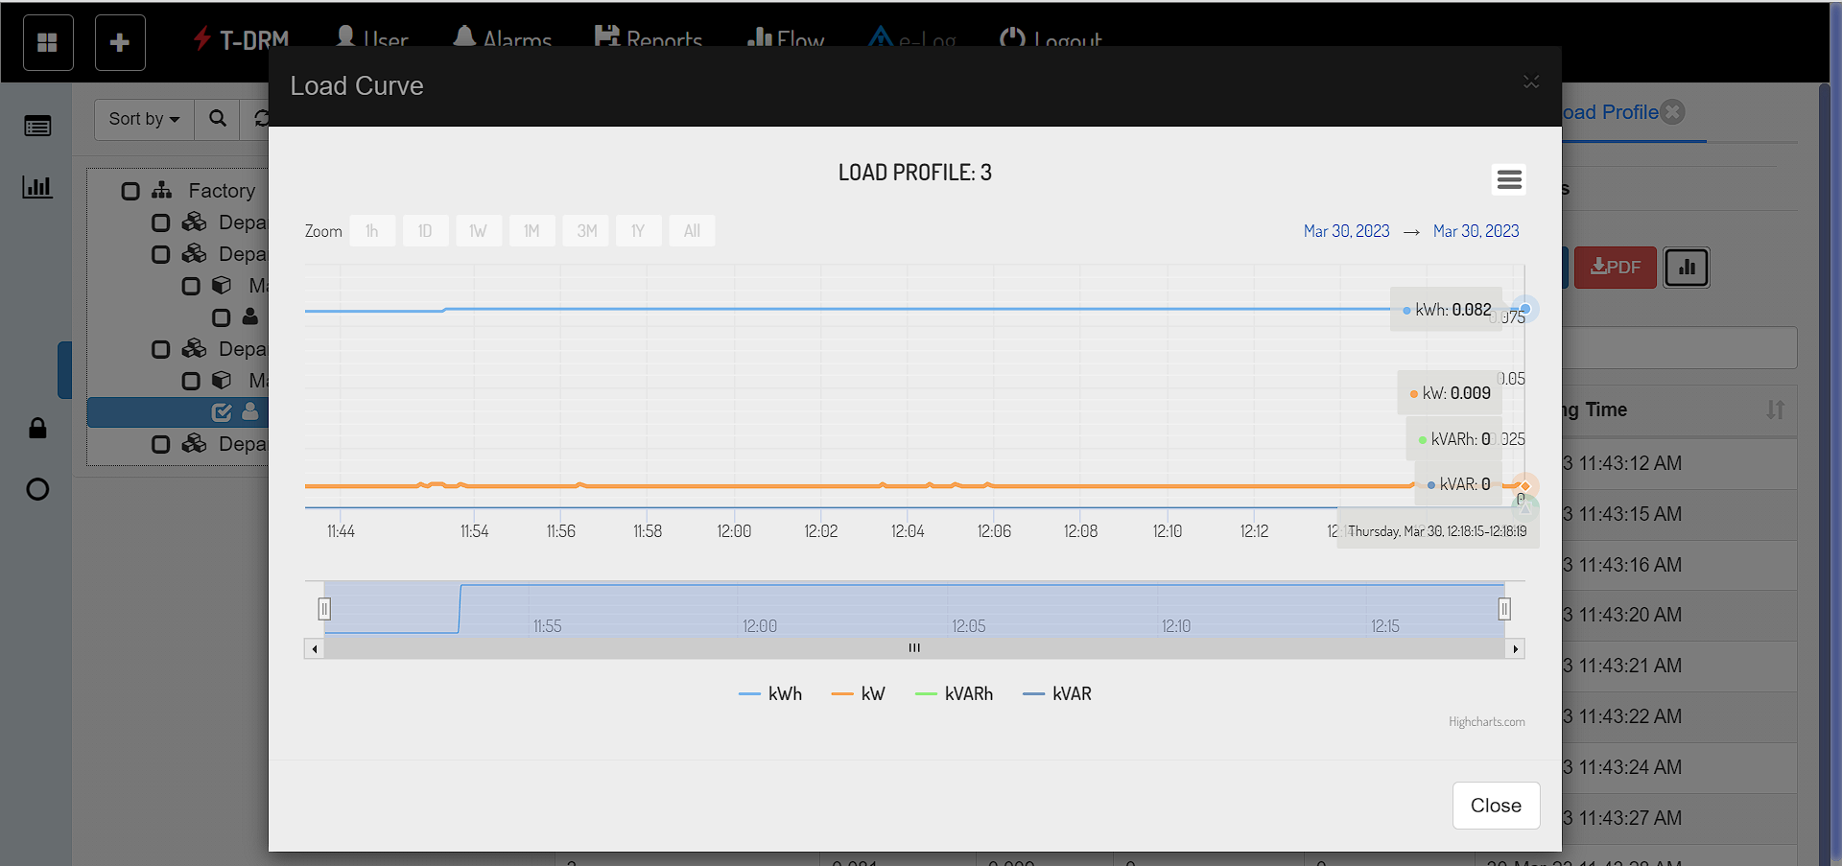
Load Profile Analysis

Slide 23
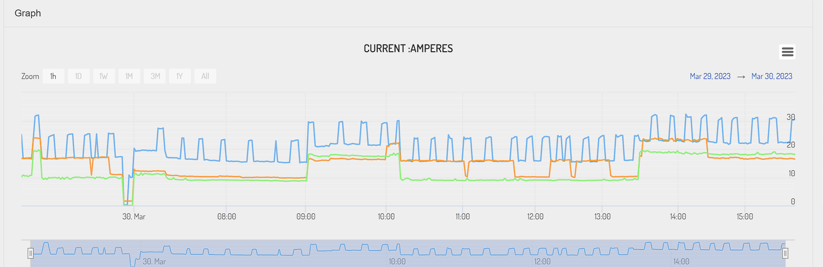
Current Analysis

Slide 24
Thankyou

